Slide 1
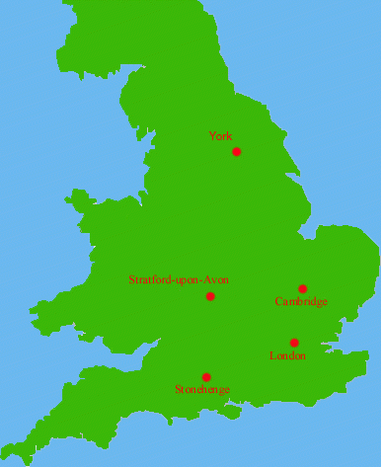

William Shakespeare
Born 1564 in Stratford upon Avon, England…April 23rd

Slide 2

Shakespeare…the facts
Parents were John—glovemaker, local politician and Mary—daughter of wealthy landowner
Shakespeare had 7 brothers and sisters
Shakespeare’s house

Slide 3
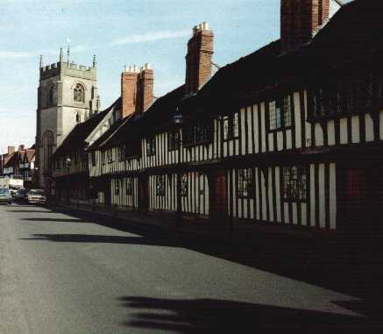
King’s New School – Shakespeare’s school
From: http://perso.wanadoo.fr/danielle.esposito/

Slide 4
Married Life
Married in November, 1582, to Anne Hathaway
Anne was pregnant at the time
First daughter Susanna born in May, 1583
Twins (Hamnet and Judith) christened on February 2, 1585
No documentary evidence between 1585-1592
Sometime in this period, he moved to London and began working in the theatre.

Slide 5
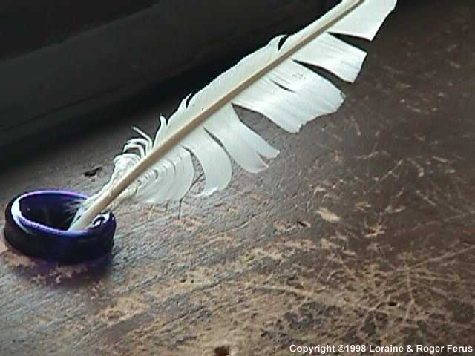
Elizabethan Playwrights
The most well known playwright of Elizabethan times is Shakespeare. But there were also other writers who in their time were just as, or even more famous than the Bard.

Slide 6
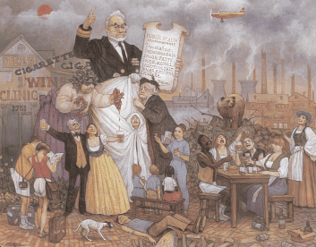
Theater Career
Member and later part-owner of the Lord Chamberlain’s Men
Theaters in London closed from 1593-1594 due to the plague

Slide 7
Theater Career
Member and later part-owner of the Lord Chamberlain’s Men
Theaters in London closed from 1593-1594 due to the plague

Slide 8
The Globe Theatre
Globe built in 1599 by the Lord Chamberlain’s Men, with Shakespeare as a primary investor
Burned down in 1613 during a production of Shakespeare’s Henry VIII when a cannon misfired and a spark landed on the thatched roof

Slide 9
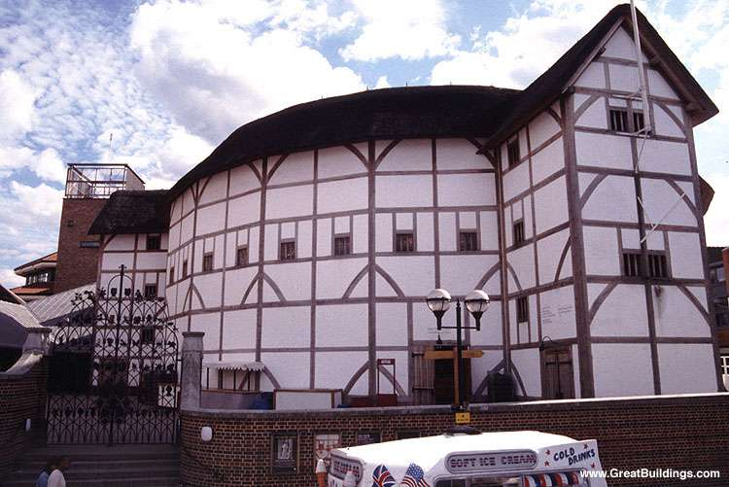
The Rebuilt Globe Theater, London

Slide 10
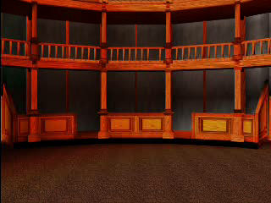
The Globe Theater

Slide 11
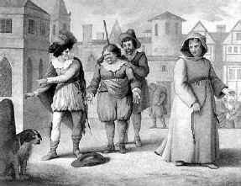
The Performances
The theatres often had mechanisms that allowed “angels” and “gods” to be lowered down onto the stage. Stages were also equipped with a trapdoor leading to a “Hell” beneath the stage. The trapdoor was also used as a grave in theatrical funerals.
There was very little scenery available for theatres, so the writers often used to dialogue to explain to the audience where the scene was taking place.
Costume was very important in Elizabethan theatre. Actors wore colourful and elaborate costumes that would tell the audience the characters status, family ties or profession.
The emphasis that was given to a character’s clothing made the theme of disguise a common convention of Elizabethan theatre. In order to exchange places with another character or conceal his identity, all an actor needed to do was to change his costume.
The Elizabethan theatre also used a variety of sound effects. Music played an important role in the setting the mood of the plays. Other sounds created were thunder, running horses, falling rain, and cannon blasts.

Slide 12

Shakespeare’s Theatre
“The Globe Theatre, also known as the Shakespeare Globe Theatre, was not only one of most famous playhouses of all time, but the play house where Shakespeare performed many of his greatest plays. Built from oak, deal, and stolen playhouse frames, the 3 storey, 3000 capacity Globe Theatre, co-owned by William Shakespeare has become almost as famous as the playwright himself.” ( Absolute Shakespeare)

Slide 13
The Stage
In Shakespeare’s Time
A show lasted about 2 ½ hours, usually in open air theatres during the afternoon.
There were no acts, but frequent intermissions.
There was no scenery, but elaborate props and costumes to give reality.
Devices such as trap doors and scaffolds were used to make gods, witches, etc. disappear.

Slide 14
The Stage
In Shakespeare’s Time (continued)
There were no actresses. All parts were played by men or boys.
There were no programs.
The closeness of stage to the audience led to use of "asides" and "soliloquies“.
In front of stage was a big open area where the "penny-public" stood to watch as they could not afford seats.

Slide 15
Julius Caesar
Gaius Julius Caesar was born in 100 B.C.
He gained power and wealth due to a series of successful campaigns in which he conquered what is now Britain, France, much of central and eastern Europe, and parts of North Africa.
The quote, “veni, vidi, vici” is aptly credited to Julius Caesar.

Slide 16
What Did Caesar Do for Rome?
He built roads.
He developed irrigation systems.
He financed public parks and buildings.
He even made changes to the calendar.
Indeed, he was well liked and very powerful.

Slide 17
What Got Caesar into Trouble?
It appears he was much more interested in things other than military conquest.
After a series of civil wars that lasted until 48 B.C., Caesar declared himself Rome’s dictator for life.
Many people believed that Caesar wanted more than just power; he wanted a powerful title.

Slide 18
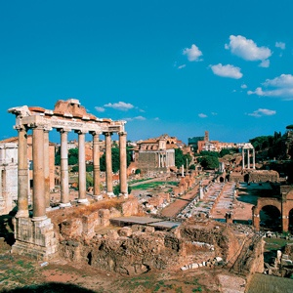
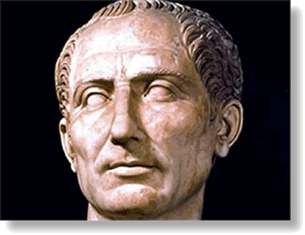
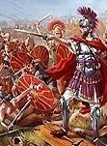
The Scene…
Based on a true story, this play takes
place in Ancient Rome,
where Julius Caesar
has just returned in
triumph from war.
The crowd hails him as their new leader, but there are some Romans who fear he will become too powerful of a ruler, more like an emperor, and they will lose the liberties they have enjoyed as citizens of a free state.

Slide 19
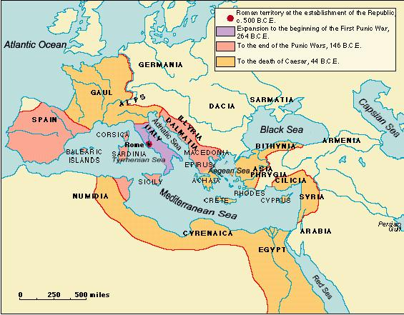
A small group of men conspire to assassinate Caesar, believing they are acting to preserve the freedoms of the Roman Republic.

Slide 20
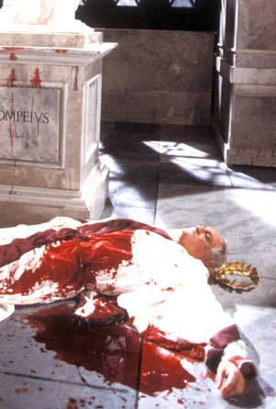
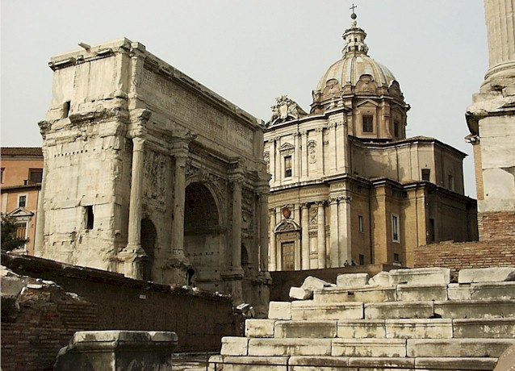
Death of Caesar
They surround him in the Forum,
and stab him to death.

Slide 21
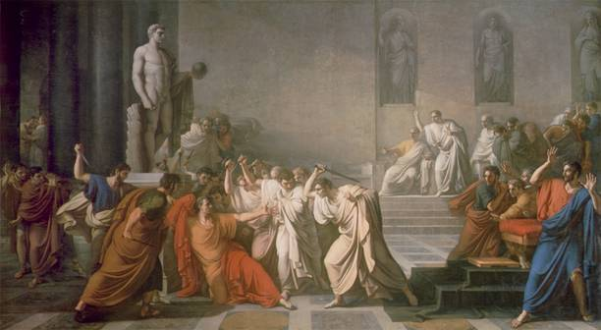
The play goes on to tell the story of what happens after the murder, as the conspirators quarrel among themselves, war erupts, and liberties, instead of being protected, appear to be lost.

Slide 23
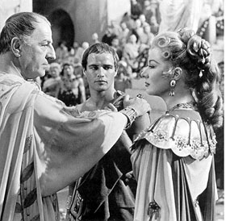
Julius Caesar
He is the head of the Roman state. He is a great soldier, and has just returned from a series of wars during which he defeated the sons of the previous Roman ruler, Pompey.
He is popular with the crowds that stand in the streets to greet his triumphal return, cheering and clapping. Calpurnia is Caesar’s wife.

Slide 24
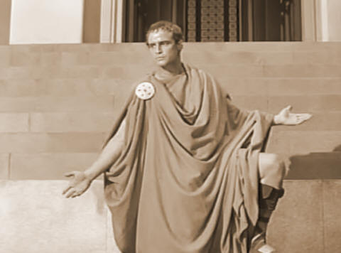
Mark Antony
He is a loyal friend and supporter of Caesar, who he believes will make a good ruler of Rome. He is appalled at the killing of the head of state, and although he shakes hands with the conspirators immediately after the murder, he vows to avenge Caesar’s death.
He gives a funeral oration over
Caesar’s dead body that stirs
the crowd to anger and desire for
revenge. He will be one of the
three rulers of Rome, after
Caesar’s death, and he gathers
an army to fight the
killers.

Slide 25
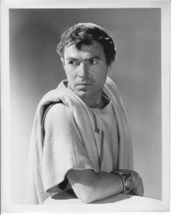
Brutus
He is a respected Roman, a man of intelligence and honor, who is a personal friend of Caesar, yet wonders whether, as a ruler, he will overstep his powers and become a tyrant rather than a good head of state.
He is finally convinced to join the conspirators as their leader. As they raise their daggers to commit the murder, Caesar recognizes his dear friend and cries, in Latin, “Et tu, Brute?” or “You too, Brutus?” Portia is Brutus’ wife.

Slide 26
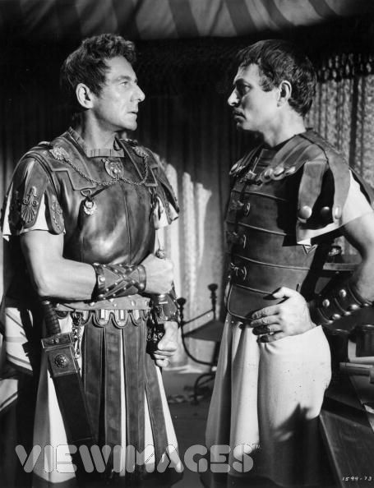
Cassius
Cassius is one of the leaders of the conspiracy. He is suspicious of Caesar from the beginning, gathers others into the band, and convinces Brutus to join with them in their plans for assassination.
He and Brutus flee Rome after the killing, each gathers an army, and they try to conquer Mark Antony’s army.

Slide 27
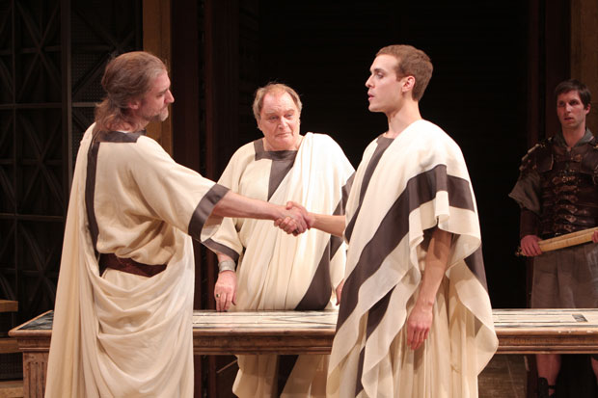
Octavius and Lepidus are the other two who join with Mark Antony after Caesar’s death to rule Rome as a triumvirate.

Slide 28
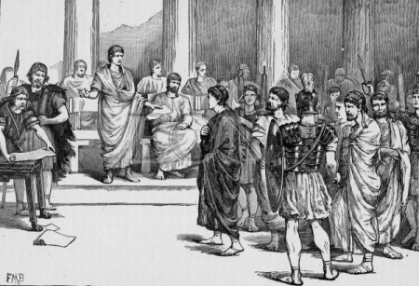
Casca, Trebonious,
Decius, Cinna
and Metallus
Cimber are the
other members of
the conspiracy,
each of whom
participates
by stabbing Caesar.

